Slide 2
Campus Security Authority Training and Reporting

Slide 3
Agenda
The “Jeanne Clery Act”:
History
Consequences for violating
Requirements
What is a Campus Security Authority (CSA)
Who is a CSA
CSA Responsibilities
Clery Crimes and their reporting requirements:
Clery Crimes
Clery Geography
Alerts
Logs
CSA Report:
What is a CSA Report
Correctly completing a CSA Report

Slide 4
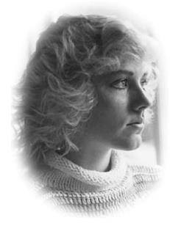
Clery Act
The “Jeanne Clery Disclosure of Campus Security Policy and Campus Crime Statistics Act”, commonly referred to as the “Clery Act”, is federal law that requires institutions of higher education in the United States to disclose campus security information including crime statistics for the campus and surrounding areas.

Slide 5
Purpose of the Clery Act
To provide students and their families with accurate, complete and timely information about crime and campus safety so that they can make informed decision.

Slide 6
Consequences for Violating the Clery Act
Specifically:
Loss of Title IV funding (financial aid).
$55,000 fine per violation.

Slide 7
Penn State University
$2.4 million dollar fine ($2.1 million not related to Sandusky incidents).
2008-2011 over 300 crimes not disclosed.
Fine was based on previous amount of $35,000 per violation
5 of which were Sexual Assault Offenses.
Source-NY Times

Slide 8
Requirements of the Clery Act
Identify Campus Security Authorities (CSAs)
Determine UNT’s Clery Geography
Collect Clery Crime Statistics
Issue Timely Warnings & Emergency Notifications
Maintain Crime/Fire Log
Publish the Annual Security & Fire Safety Report
Submit crime/fire statistics to the US Department of Education

Slide 9
Campus Security Authorities

Slide 10
Identifying Campus Security Authorities
In order to ensure all criminal activity is disclosed, the Clery Act requires UNT to identify individuals and the organizations to which crimes may be reported as a result of their position with UNT.
These individuals and organizations are called Campus Security Authorities (CSAs).
If you’re participating in this training, UNT has identified your position as a CSAS and you have specific responsibilities that are required by federal law!

Slide 11
UNT Campus Security Authorities
Members of the UNT Police Department.
Individual(s) who has a responsibility for campus security but are not members of the UNT Police Department.
(i.e. event security or monitors entrance into buildings)
Individual(s) or organizations specified in a UNT statement of campus security policy as someone student should report criminal offenses.
Individual(s) who has a significant responsibility for student and campus activities, including, but not limited to student housing, student discipline and campus judicial proceedings

Slide 12
UNT Campus Security Authorities
Examples:
Dean of Students
Director and Coaches of Athletics
Faculty Advisor to student group
Housing Resident Advisor
Anyone who monitors access to dorms or buildings owned by student orgs
Greek Life Staff
Title IX Coordinator
Ombudsperson
Director of campus health or counseling center
Victim advocates or other responsible for victim advocacy
Members of a sexual assault response team/sexual assault advocates

Slide 13
Not Campus Security Authorities
Faculty member who does not have any responsibility for students and campus activity beyond the classroom.
Clerical or cafeteria staff.
Facilities or maintenance staff.
Any support position that does not have significant responsibility for students and campus activities.

Slide 14
Clery Crimes/Geography

Slide 15
Clery Crimes
Clery Crimes reported to a CSA must immediately be reported to the UNT Police!!!
Criminal Homicide
Murder, Non-Negligent, & Manslaughter by Negligence
Sexual Assault (Sex Offenses)
Rape, Fondling, Incest, & Statutory Rape
Robbery
Aggravated Assault
Burglary
Motor Vehicle Theft
Arson
Hate Crimes
Bias based on Race, Religion, Sexual Orientation, Gender, Gender Identity, Ethnicity, National Origin, Disability
Violence Against Women Act (VAWA)
Dating Violence, Domestic Violence, & Stalking

Slide 16
Clery Crimes
Criminal Homicide
Murder & Non-Negligent Manslaughter- Willful (non-negligent) killing of another human being by another.
Manslaughter by Negligence- Killing of another person through gross negligence.

Slide 17
Clery Crimes
Sexual Assault (Sex Offenses)
Rape- Penetration, no matter how slight, of the vagina or anus, with any body part or object, or oral penetration by a sex organ of another person without consent.
Fondling- Touching of the private body parts of another person for the purpose of sexual gratification, without the consent of the victim, including instances where the victim is incapable of giving consent because of age or mental incapacity.
Incest- Sexual intercourse between persons who are related to each other within the degrees marriage is prohibited by law.
Statutory Rape- Sexual Intercourse with a person who is under the statutory age of consent.

Slide 18
Clery Crimes
Robbery- The taking or attempting to take anything of value from the care, custody, or control of a person(s) by force or threat of force resulting in victim fearing for their safety.
Aggravated Assault– An unlawful attack by one person upon another for the purpose of inflicting severe or aggravated bodily injury.
Burglary– Unlawful entry of a structure to commit a felony or a theft.
Motor Vehicle Theft– Theft or attempted theft of a motor vehicle.
Arson– Any willful or malicious burning or attempt to burn, with or without intent to defraud, a dwelling house, public building, motor vehicle or aircraft, personal property of another.

Slide 19
Clery Crimes
Hate Crimes
A criminal offense where victim was intentionally selected because of perpetrator’s bias against them.
(Race, Religion, Sexual Orientation, Gender, Gender Identity, Ethnicity, National Origin, Disability)
Larceny (Theft)- Unlawful taking, carrying, leading, or riding away of property from the possession or constructive possession of another.
Simple Assault – Unlawful physical attack by one person upon another where neither the offender displays a weapon, nor the victim suffers obvious sever or aggravated bodily injury.
Intimidation – Unlawfully placing another person in reasonable fear of bodily harm through the use of threatening words and/or other conduct, but w/o displaying a weapon or subjecting victim to a physical attack.
Destruction/Damage/Vandalism of Property - To willfully or maliciously destroy, damage, deface, or otherwise injure or personal property without the consent of the owner or the person having custody or control of it.

Slide 20
Clery Crimes
Violence Against Women Act (VAWA)
Dating Violence – Violence committed by a person who is or has been in a social relationship of a romantic or intimate nature with the victim.
Domestic Violence – A felony or misdemeanor crime of violence committed;
by a current or former spouse,
person with whom the victims shares a child in common,
a person who currently or formerly cohabited with as a spouse or intimate partner,
a person situated to a spouse of the victim under domestic or family violence laws of their jurisdiction,
by any other person against an adult or youth victim who is protected from that person’s acts under the domestic or family violence laws of the jurisdiction which the crime occurred.
Stalking – Engaging in a course of conduct directed at a specific person that would cause a reasonable person to;
fear for the person’s safety or safety of others; or
suffer substantial emotional distress.

Slide 21
Arrests/Disciplinary Referrals
Weapons Violations. – Violations of laws prohibiting the manufacture, sale, purchase, transportation, possession, concealment, or use of firearms, cutting instruments, explosives, incendiary devices, or other deadly weapons.
Drug Abuse Violations – Violation of laws prohibiting the production, distribution, cultivation, importation, and/or use of certain controlled substances and the equipment utilized in their preparation and/or use. Arrests for violations of state or local laws specifically those relating to the unlawful possession, sale, use, growing, manufacturing and making of narcotic drugs.
Liquor Laws Violations – Violation of state or local laws or ordinances prohibiting the manufacture, sale, purchase, transportation, possession, our use of alcoholic beverages, not including driving under the influence offenses.

Slide 22
Clery Geography
On Campus- Property owned or controlled by UNT that is reasonably contiguous to one another and directly support or relates to UNT’s education purpose.
Main Campus (i.e. Hurley, Willis, GAB, Union, and Life Science).
Public Property- All public property , including thoroughfares, streets, sidewalks, and parking facilities, that is within campus, or immediately adjacent to and accessible from the campus.
Highland Street (including sidewalks), North Texas Blvd, or Ave A in front Fry Street Bars.
Non-Campus- Buildings or property owned or controlled by an officially recognized student organization or buildings owned or controlled by UNT for educational purposes, is frequently used by student that is not within Main Campus.
Discovery Park, UNT on the Square, Library Annex, or RUAC.
Including Study Abroad and Student Organization Travel Locations.

Slide 23
Public Notification

Slide 24
Alerting Campus Community
Timely Warnings - A warning to the community that must be issued for any Clery Crime that occurs on UNT’s Clery Geography and is considered to represent a serious or continuing threat to students and employees.
Emergency Notification – A notification that must be initiated for any significant emergency or dangerous situation involving an immediate threat to the health or safety of students or employees occurring on the campus.

Slide 25
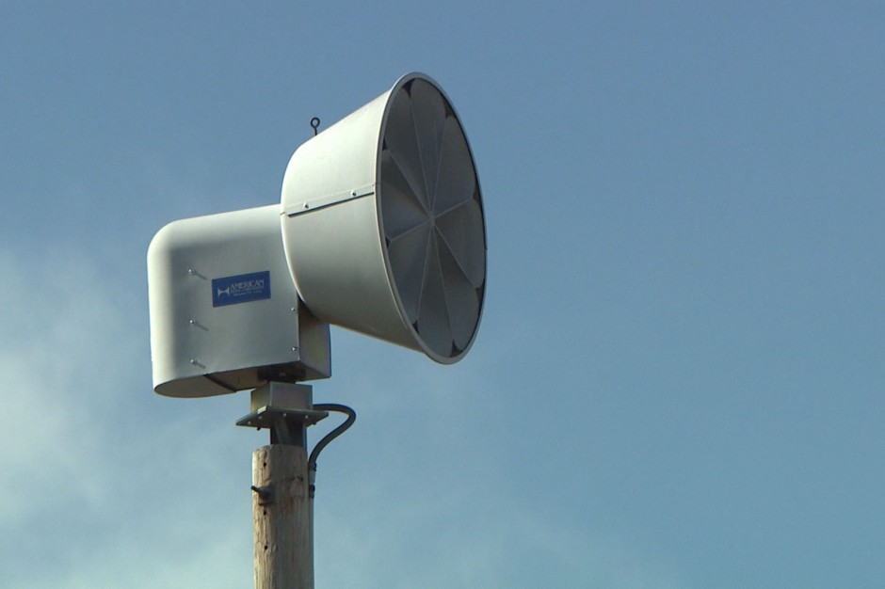
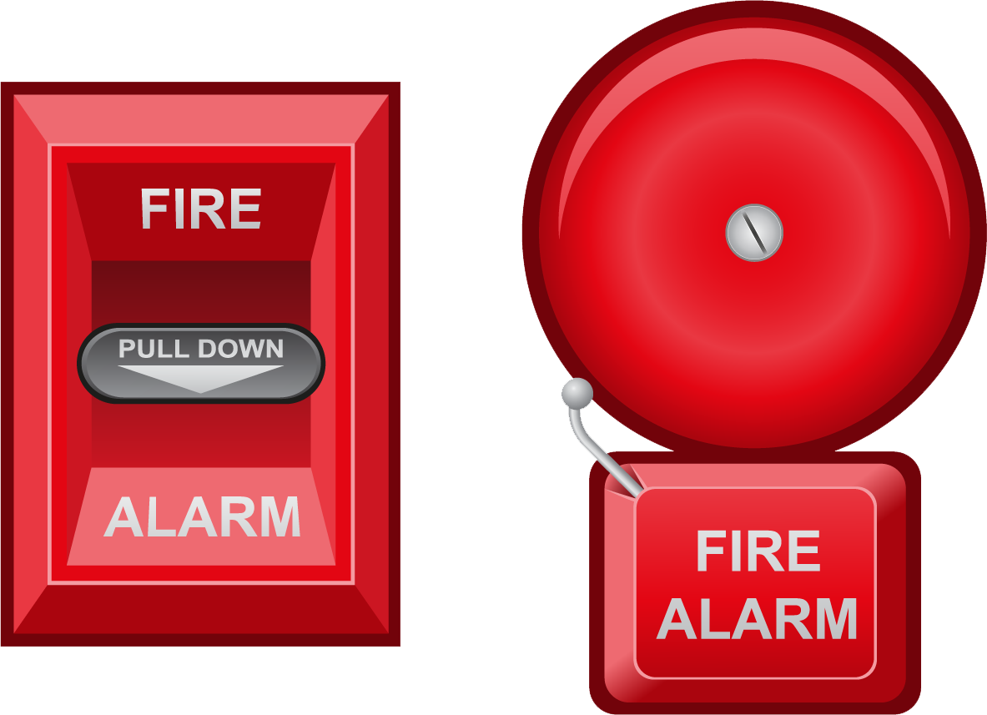
Emergency Notification
Timely Warning

Slide 26
Daily Crime Log
Daily Crime Log – A record of criminal incidents and/or alleged criminal incidents that are reported to the UNT Police Department and made available to the public. The log must contain the following:
Date the crime was reported
Date and time the crime occurred
Nature of the crime
General Location of the crime
Disposition of the Complaint, if known
The Daily Crime Log is the most comprehensive list of crime reports on campus.
Crime Log can be attained at:
UNT website- http://police.unt.edu/CrimeLog.html or
UNT Police Department (1700 Wilshire St)

Slide 27
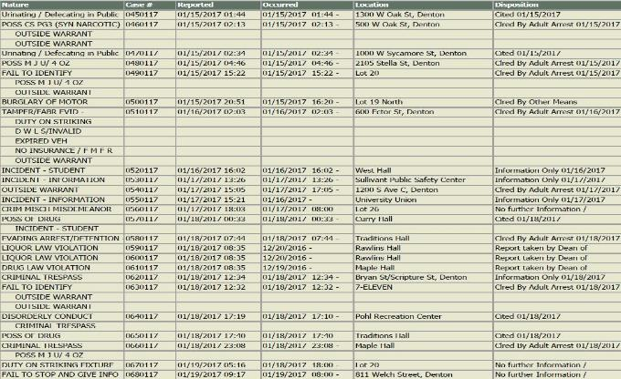

Slide 28
Fire Log
Fire Log – A record of any fire that occurs in an on-campus student facility. The log must contain the following:
The date the fire was reported
Date and time the fire
Nature of the fire
General location of the fire
A copy of the Fire Log can be found at UNT’s Risk Management’s Office.
(700 North Texas Blvd)

Slide 29
Annual Security and Fire Safety Report
ASFSR – Annual report published and distributed by the University no later than October 1st of each year that describes campus safety and security policies and reports University crime and fire statistics.
Includes:
Crime Reporting Information
UNT policies pertaining to safety
Evacuation and Emergency Procedures
Resource information
Institutional disciplinary procedures
Public safety program information
Annual Security and Fire Safety Report can be found at:
http://clery.unt.edu

Slide 30
Annual Security and Fire Safety Report
Institution must include a statement on how UNT will protect the confidentiality of the victim.
This includes letting them know:
Personal identifying information will not be included on publicly available records.
Accommodations or protective measure provided, to the extent that it does not interfere with these accommodations or protective measures.

Slide 31
CSA Responsibilities

Slide 32
CSA Responsibilities
Report to the UNT Police Department all alleged Clery crimes reported to you as a CSA.
Does Not include incidents:
Overheard in hallway
If student mentions during classroom discussion
During a speech
In a workshop
A group presentation
Learned about in an indirect manner
These reports will be used to:
Fulfill UNT’s responsibility to annually disclose Clery crime statistics.
To issue timely warnings for Clery crimes that pose a threat to the campus community.
Enter the information on the daily crime log.

Slide 33
CSA Responsibilities
Provide information to victim on how to report a crime to the UNT Police Department.
If the person does not want to contact the police, CSA should report the crime to the UNT Police Department.
If person states they will report the crime themselves, CSA should follow up and verify if the crime was reported to the UNT Police Department.
Incidents may be beyond CSA’s comfort level
(i.e. Rape, Stalking, etc..).
Consider guiding person to UNT organizations trained to handle such incidents.
Dean of Students Office- 940-565-2648
Title IX Office- 940-565-2759

Slide 34
Reporting
Police Report: A report used by the UNT Police Department to initiate a criminal investigation.
UNT Police- 911 or 940-565-3000(1)
www.police.unt.edu
Sullivant Public Safety Center
1700 Wilshire ST.
Denton, TX 76201
CSA Report: An online report made by CSA which will be sent to the UNT Police Department that meets Clery requirements after submission.
http://clery.unt.edu

Slide 35
CSA Responsibilities
Notify students and employees about existing resources (on-campus & off-campus).
On-Campus Resources
Counseling & Testing
Health & Wellness Center
Meadows Center for Health Resources
Psychology Clinic
Counseling & Human Development Center
Child & Family Resources Clinic
Student Legal Services
Off-Campus Resources
Denton Regional Medical Center
Denton County Friends of the Family
Denton County Health Department
Denton Police Department
http://studentaffairs.unt.edu/student-health-and-wellness-center/resources
http://dentoncounty.com/Pages/Social-Service-Agencies.aspx

Slide 36
Helping
Guide survivors to resources:
UNT Survivor Advocate-@ survivoradvocate@unt.edu
UNT Police Department@940-565-3000
Denton County Friends of the Family@940-382-7273
Never judge or blame survivors:
Tell them you are sorry they’ve been hurt.
Tell them they are NOT responsible or to blame (perpetrator is).
Lend a listening ear & validate their feelings:
Do not force the issue but allow them to talk w/ you at their own pace.
Focus on supporting their right to make their own decision what to do.

Slide 37
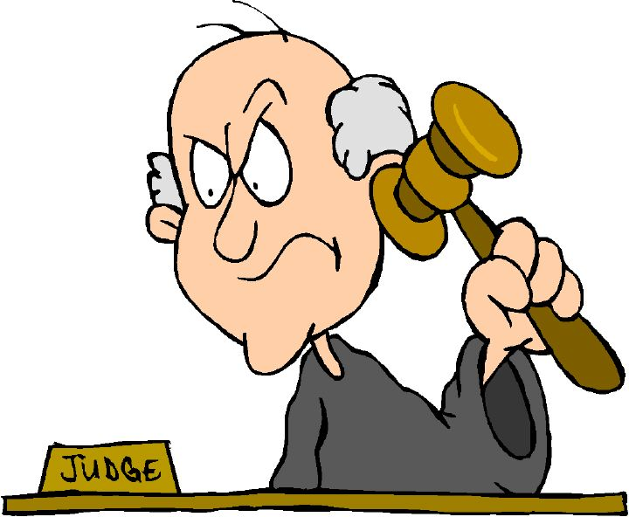
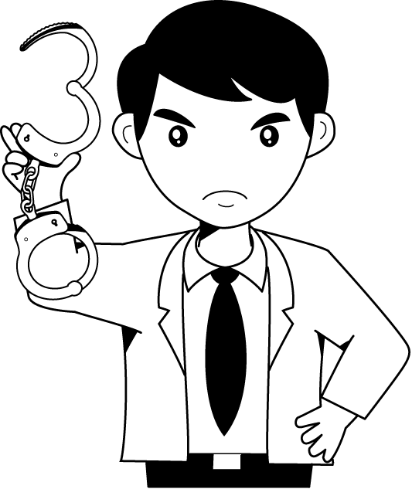
Not a CSA Responsibility
Investigating a crime.
Determine whether a crime occurred.
Apprehending criminals.

Slide 38
CSA Reporting
This section is specifically focused on accurate reporting of an incident.

Slide 39
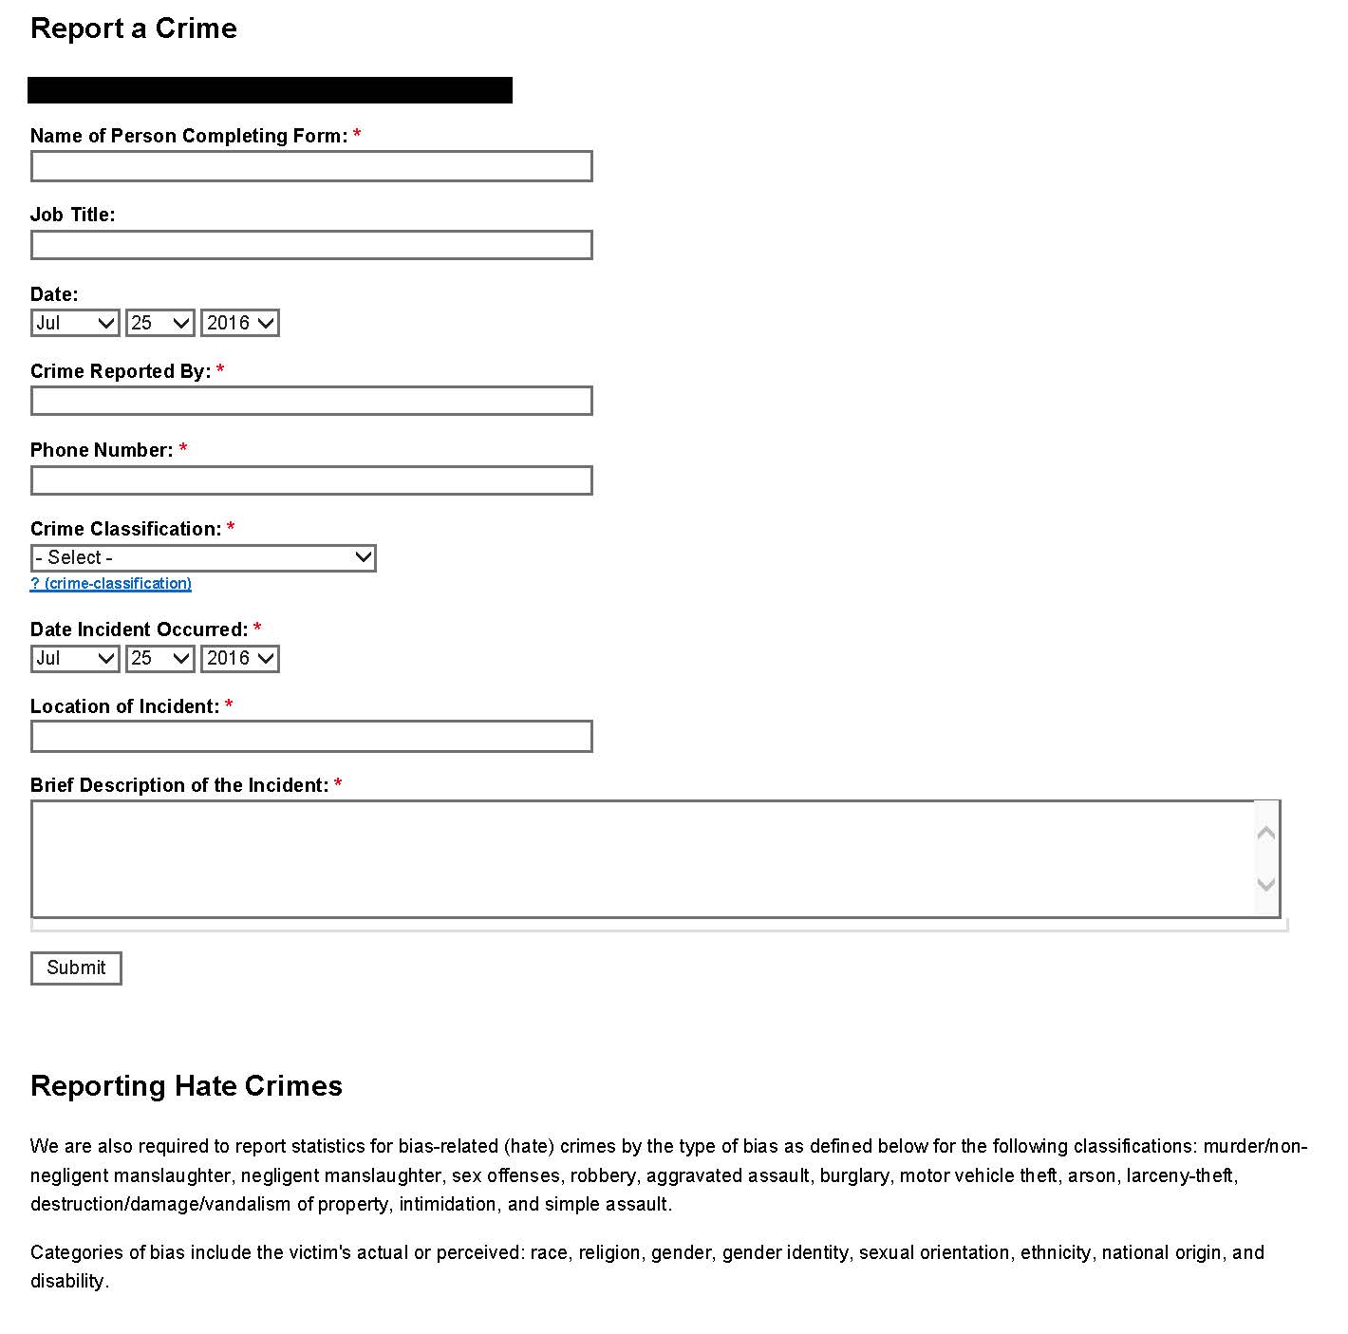
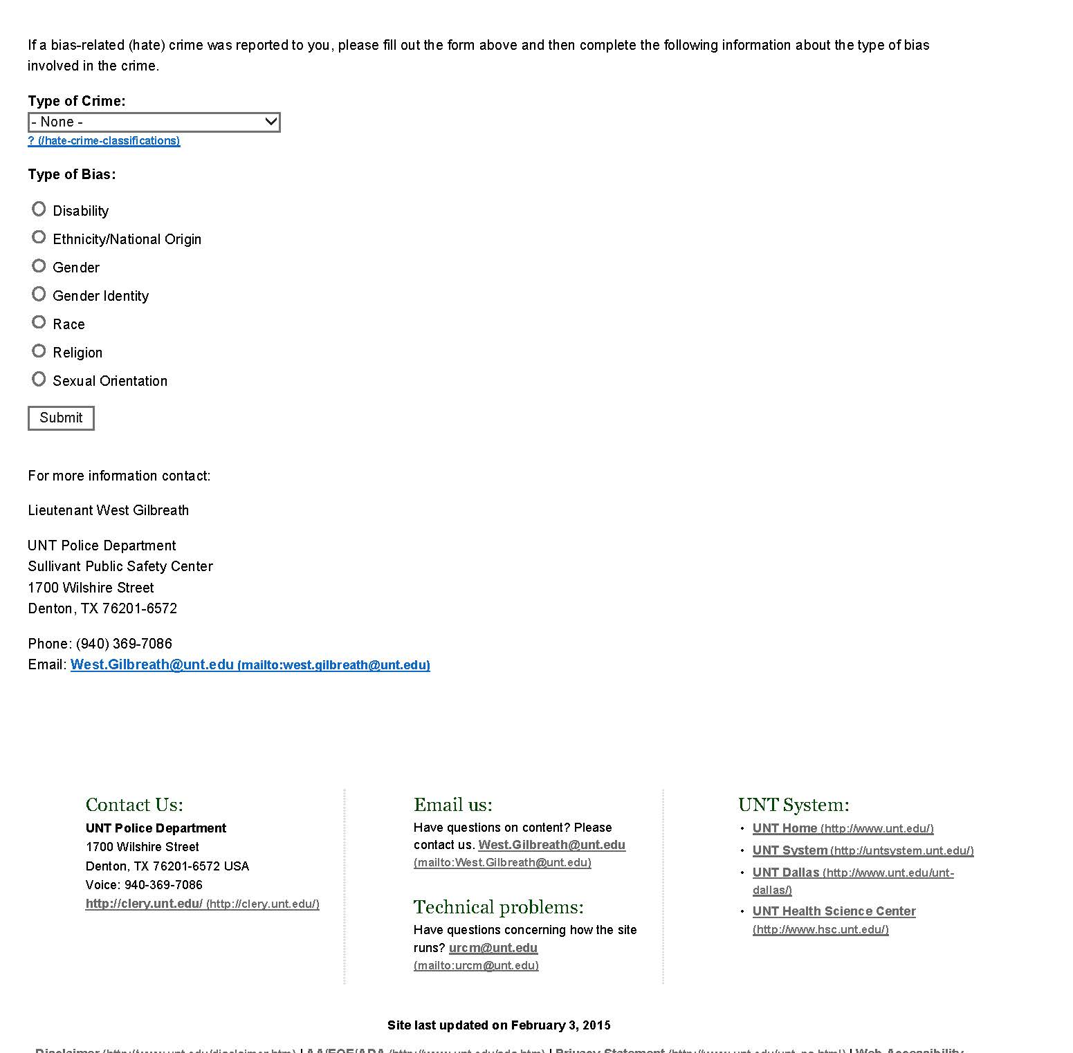
CSA Reporting

Slide 40
CSA Reporting
Must have information for CSA Report:
Who was involved
What occurred
Where did it occur
When did it occur
How did it occur
The accuracy in the information provided can assist with the:
Criminal investigation
Annual reporting requirements
The issuance of a timely warning if appropriate
After submitting the CSA report you will receive an email confirming submission.
Retain the email for your records!

Slide 41
CSA Reporting
The CSA should ask themselves if they know the:
Who:
Crime being reported by (Both CSA and Victim).
What:
Clery Crime being reported (Fondling).
Where:
Location crime occurred (Traditions Hall)
When:
The date the crime was reported.
The date and time the crime occurred.
How:
Describe in detail how the offense occurred.
Clery reporting accuracy is in the details.
You may hear from UNTPD or other UNT official regarding the crime.

Slide 42
CSA Reporting
Scenario
A CSA is told by a student that the student was sexually assaulted (grabbed on the buttocks) in a dorm room last night.
Is the CSA ready to make a CSA Report?
Do you know if the student wants to speak with the police or other campus official?
Has the student provided you with their identity and consented to sharing it for the report?
Has the student identified the perpetrator and consented to sharing their identity for the report?
Were you given specific details of the offense which allows you to correctly identify the Clery crime (rape or fondling)?
Do you know in which dorm and in what room the offense occurred?
Do you know when exactly the offense occurred (date and time)?

Slide 43
Practical Exercise

Slide 44
CSA Reporting
Scenario
A student named J. Smith who lives in Kerr Hall, room # 321 reports to you that J. came home last night around 11:00pm and discovered their laptop was stolen out of their room. J. Smith explains no one else has lawful access to the room and believes the thief (unknown identity) gained entry into the room because the door was left unlocked.

Slide 45
CSA Reporting
Did you ask yourself:
Is this crime a Clery Reportable Crime?
Do you know the correct Clery Crime?
Did this occur in UNT Clery Geography?
When did this crime occur?
Does the victim wish to be contacted by the UNTPD?

Slide 46
CSA Reporting
Who:
CSA-Kevin Crawford, Victim-J. Smith.
What:
Burglary (Unlawful entry of a structure to commit theft).
Where:
Kerr Hall #321.
When:
Date Reported- (Today's date).
Date and Time Occurred- (Yesterday’s date), 11:00pm.
How:
Student J. Smith reported upon returning to the dorm room J. discovered their laptop was stolen by an unknown person. Smith stated no one else has access to the room but the door was left unlocked.

Slide 47
Closing

Slide 48
Important Links
http://clery.unt.edu/
Annual Security and Fire Safety Report
Crime Alerts
Report a Crime (CSA Report)
CSA Training Slides
www.police.unt.edu
(Public Information Tab)
60-Day Crime Log
Crime Alerts
www.deanofstudents.unt.edu
(Sexual Misconduct Tab)
Definitions
Resources
Response
Contact

Slide 49
Closing
Remember as a CSA you have a legal responsibility to make the
UNT Police Department aware of Clery Crimes.
For assistance and/or questions please contact:
Captain West Gilbreath at:
West.gilbreath@unt.edu

Slide 50
Questions ????
State of the University

